Slide 1
Intern project showcase
Doan Duy Duc – Localization Services

Slide 2
About myself…
Name : Doan Duy Duc
University : Nanyang Technological University
Major : Computer Engineering
Grad Date : July 2018
Team : Localization Services
Manager : Mr. Murtaza Bhori – Supervisor : Mr. Pradip Patil
Project Title : Chamel10n – Web Automation Framework

Slide 3
Project introduction
Chamel10n – a Web Automation Framework
Easily
manage different application’s type using
Pluggable
adapter
based mechanism
Application
independent test cases. Write once, run
Reusable
against all
Run test
suite against a set of user selected
Language Independent
languages
Multiple test
case types supported. Scan and
Flexible
Compare Test Case

Slide 4


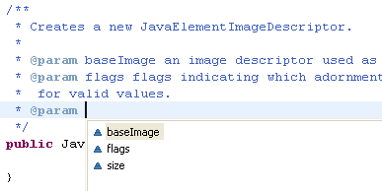




Project process
Migrate Code
Add Functionalities
Documentation

Slide 5
Project results
CURRENT RESULT
The system is stable to run different test cases against different types of inputs
Performance is improved as number of test cases increase
All current unit tests are passed
WHAT TO DO NEXT ?
Add more test cases
Continue with the Plug mechanism
Add unit tests in parallel
Once finished, finalize javadoc

Slide 6
Take Home experiences
New technology
Coding skills : OOP, code review from senior developer,…

